Slide 1


E D U C A T I O N A L P S Y C H O L O G Y S E R V I C E
Sociograms
Mapping Peer Relationships

Slide 2

What is a sociogram?
E D U C A T I O N A L P S Y C H O L O G Y S E R V I C E
A sociogram is a visual representation of interpersonal relationships within a group.
It can be especially useful in an educational context, in order to help teachers and other staff understand more about pupils' peer relationships. It is often a useful starting point for identifying and addressing the social and emotional needs of pupils.

Slide 3
What is a sociogram?
E D U C A T I O N A L P S Y C H O L O G Y S E R V I C E
Sociograms are made on the basis of pupils' nominations of classmates in response to questions. Pupils nominate three classmates with whom they most like to play/spend free time and three classmates with whom they least like to play/spend free time (wording can vary).
Recording the positive and negative nominations received by each pupil helps staff to be aware of patterns of acceptance and rejection within the peer group.
The sociogram reveals the peer group dynamics of a class or other pupil group in a visual and accessible way.

Slide 4
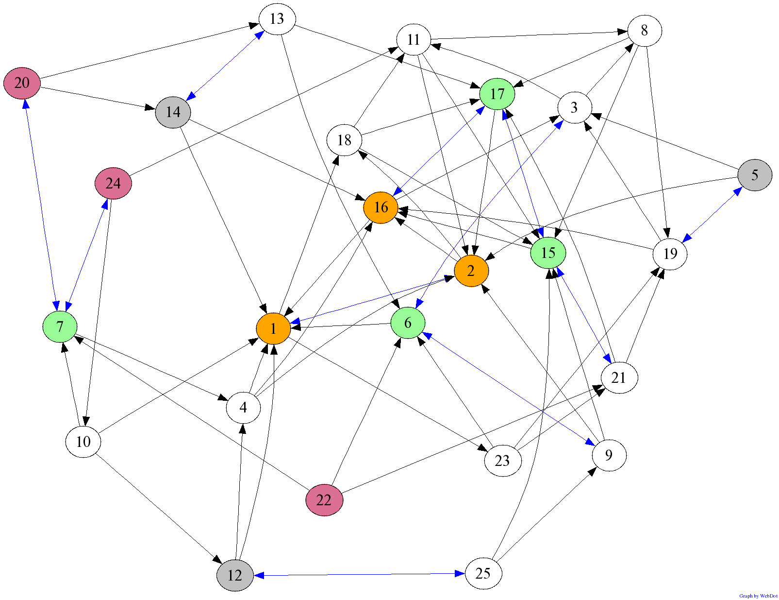
Why focus on peer relationships?
E D U C A T I O N A L P S Y C H O L O G Y S E R V I C E
Poor peer acceptance is linked to loneliness and social dissatisfaction.
In the longer term, poor peer relationships are linked to problematic behaviours, aggression, depression and academic achievement.
Peer contact and friendship is linked to resilience in the face of adversity.

Slide 5
Goals of Peer Interaction
E D U C A T I O N A L P S Y C H O L O G Y S E R V I C E
Key Stage 1: development of co-ordinated play
Peers are help givers and companions.
Key Stage 2: Group Acceptance
Peers are evaluators and social comparison becomes more important.
Adolescence: Intimacy and self-disclosure.
- Peers take over from parents as main confidant.

Slide 6

E D U C A T I O N A L P S Y C H O L O G Y S E R V I C E
Schools can make a difference
Social and Emotional Learning Programmes
(e.g. SEAL, FRIENDS) can lead to significant
improvements in:
  Social and emotional skills
  Attitudes about self, others and school
  Classroom behaviour
  Emotional distress
  Achievement
Sociometric measures can be used to identify
higher-risk children.

Slide 7
Interpreting a Sociogram
E D U C A T I O N A L P S Y C H O L O G Y S E R V I C E
Average: a few positive and a few negative nominations
Popular: lots of positive nominations and a few negative nominations
Controversial: lots of positive and lots of negative nominations.
Neglected: very few nominations in either category
Rejected: lots of negative nominations and few positive nominations.

Slide 8
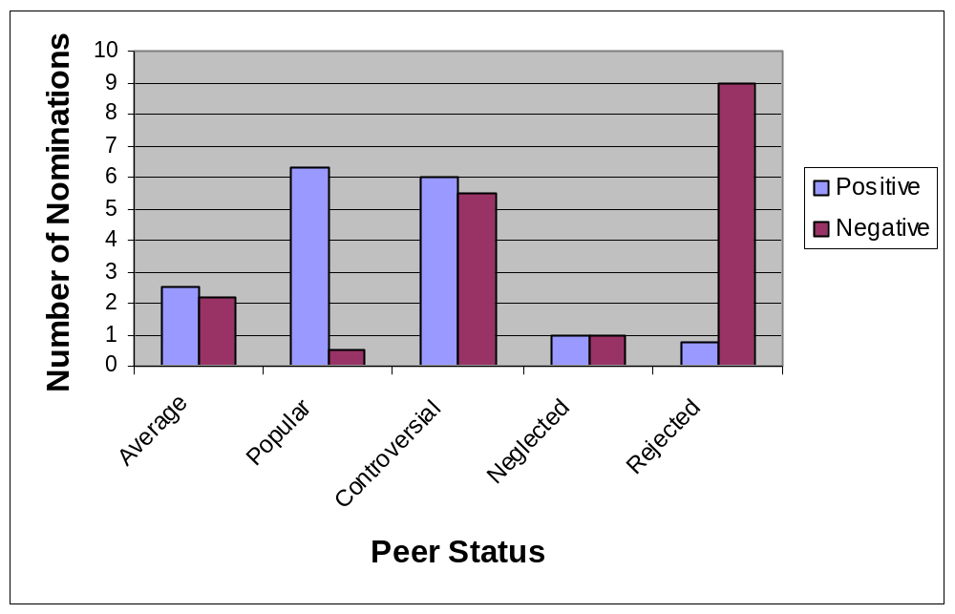

E D U C A T I O N A L P S Y C H O L O G Y S E R V I C E
Peer Status

Slide 9
E D U C A T I O N A L P S Y C H O L O G Y S E R V I C E
Behavioural Reputation
Popular More cooperative Less disruptive Less aggressive Seen as a leader | Rejected Less cooperative Seen less as a leader | Controversial Most disruptive Most aggressive

Slide 10
Activity
E D U C A T I O N A L P S Y C H O L O G Y S E R V I C E
In groups look at the 3 sociograms,
completed for a class over the period of 1
year.
What general trends can you notice
Look at a couple of children and track those whose status has changed for each sociogram – can you suggest why?

Slide 11
Getting started….
E D U C A T I O N A L P S Y C H O L O G Y S E R V I C E
Select your group
You will be asking them to tell you 3 children they like/don’t like and this is the data you will be feeding into the spread sheet on the website.
For young children you can show them the class pictures for them to pick children they like/don’t like to play with.
For older children they can complete a sheet.

Slide 12
E D U C A T I O N A L P S Y C H O L O G Y S E R V I C E
How to collect your data
Class: School: Date:
My Code: boy or girl
Use the code numbers on your class list to answer each question.
The three children in my class who I MOST like to play with ___ ___ ___
        hang out with ______________
The three children in my class who I LEAST like to play with ___ ___ ___
hang out with ______________

Slide 13
E D U C A T I O N A L P S Y C H O L O G Y S E R V I C E
Info Tab
School:
Class:
Date:
ID | NAME

Slide 14
How to analyse your survey
E D U C A T I O N A L P S Y C H O L O G Y S E R V I C E
Open the website:
http://www.sussex.ac.uk/Users/robinb/socio.html
Click ‘Recording and formatting sociometric data’
Download the Excel spreadsheet (click ‘here’)

Slide 15
E D U C A T I O N A L P S Y C H O L O G Y S E R V I C E
Data Tab
ID | ML1 | ML2 | ML3 | LL1 | LL2 | LL3
1 | 4 | 8 | 9 | 2 | 6 | 3
2 | 3 |  |  | 6 | 8
3 | 4 | 7 | 8
After you have entered the data you will probably want to save the spreadsheet for future reference.

Slide 16
E D U C A T I O N A L P S Y C H O L O G Y S E R V I C E
Matrix Tab
This summarises the info. you have added.
Each column maps the nominations for one child onto the other children in the class.
The bottom row gives total number of ML and LL nominations for each child.
 | 1 | 2 | 3 | 4 | 5 | 6 | 7 | 8
ML | 7 | 7 | 7 | 3 | 0 | 0 | 0 | 0
LL | 0 | 0 | 0 | 0 | 5 | 5 | 5 | 0

Slide 17
Text Tab
E D U C A T I O N A L P S Y C H O L O G Y S E R V I C E
Highlight data and copy (Edit Menu)
Go back to website and download ‘socio file creator’ – choose the appropriate one (most likely ML and LL for Windows).
Select ‘run’ if it asks.
When the socio file creator opens press ‘click to paste your data’. The data you copied should go into the box.

Slide 18
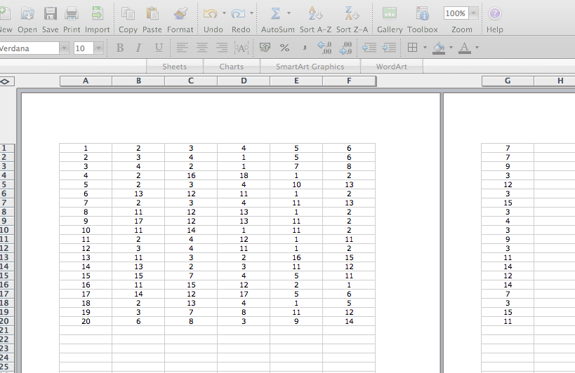

Slide 19
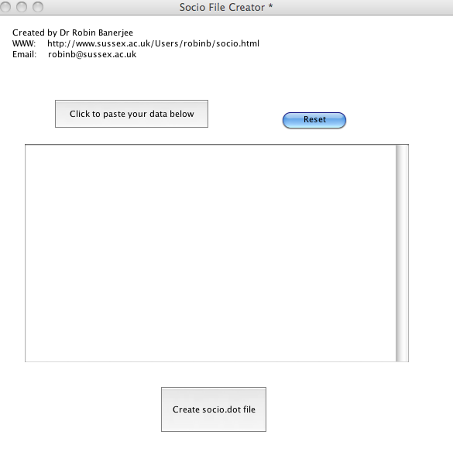

Slide 20
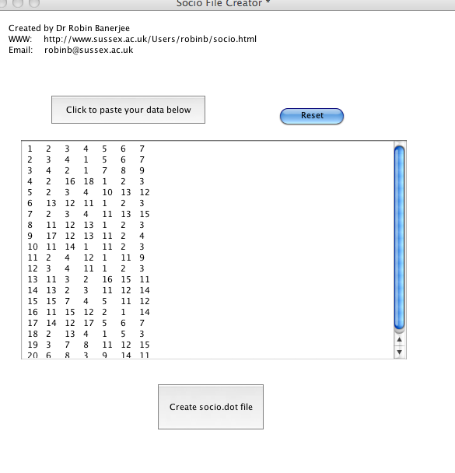

Slide 21
E D U C A T I O N A L P S Y C H O L O G Y S E R V I C E
Creating your sociogram
Press ‘create socio.dot file
You should get a message ‘socio.dot file has been created. Press OK to quit’. Press OK!
You then need to find out where the computer has saved the file!
Tip- use the ‘search’ function to look for files containing ‘socio.dot’.

Slide 22
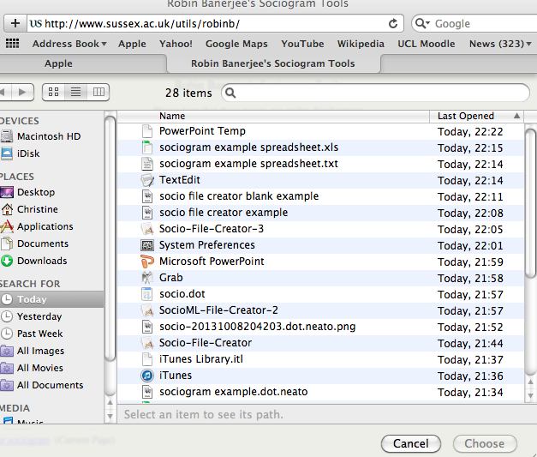

Slide 23
E D U C A T I O N A L P S Y C H O L O G Y S E R V I C E
Viewing the sociogram
Go back to the website and click ‘viewing your sociogram’.
Select ‘browse’ and find your file
Select ‘upload’
You should get a message ‘generating graph’. This can take 1-2 mins.
Your sociogram will appear below! (If not you might need to right click and choose ‘show picture’)
You can then right click on the sociogram and save it to look at later.

Slide 24
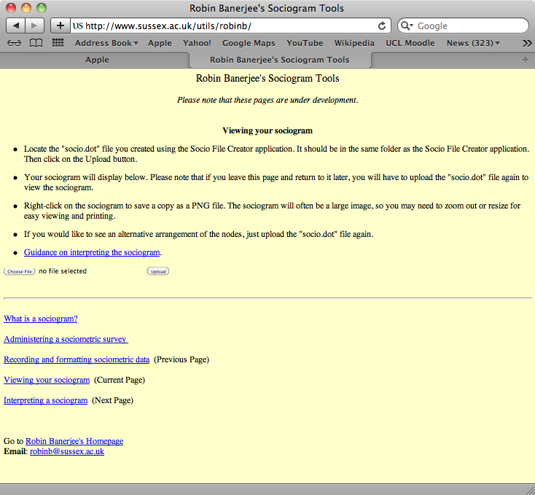

Slide 25
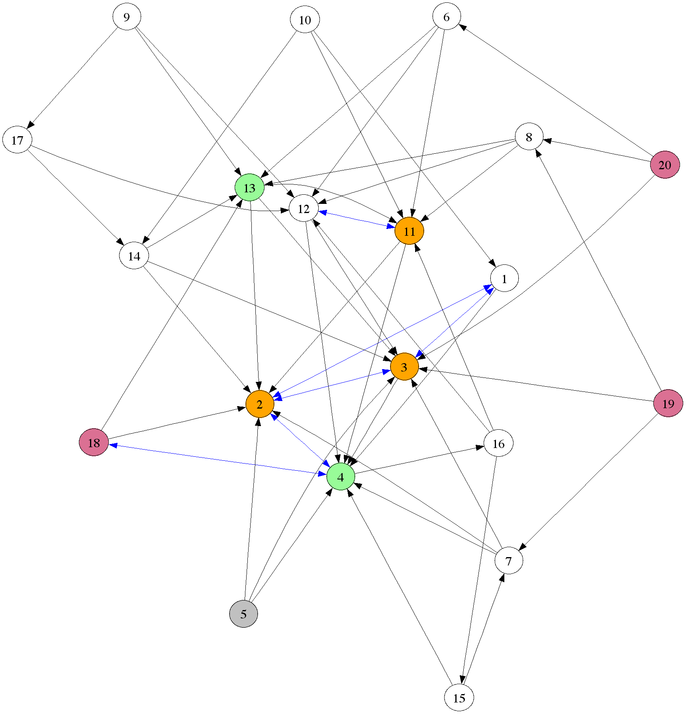

Slide 26
E D U C A T I O N A L P S Y C H O L O G Y S E R V I C E
Interpreting your sociogram
Each child in the class is a node.
Arrows indicate ML nominations.
Double headed arrows indicate reciprocated ML nominations.
When this is linked to LL, the coloureds nodes suggest the following:
  Green = popular
  Grey = rejected
  Pink = neglected
  Orange = controversial
  White = average

Slide 27
E D U C A T I O N A L P S Y C H O L O G Y S E R V I C E
Things to look for…
Look at profile and peer networks of individual children.
Look for groups of pupils that stand out.
Look at the rejected children in more depth.

Slide 28
…so what does this mean?
E D U C A T I O N A L P S Y C H O L O G Y S E R V I C E
E D U C A T I O N A L P S Y C H O L O G Y S E R V I C E
Popular: Generally socially competent pupils
Controversial: Less stable classification
Often dominant and perceived as popular, but can be disruptive and aggressive, with a significant impact in the class.
Neglected/Low social impact, these pupils usually well-adjusted, if shy.
Rejected: Most stable classification, i.e. difficult to shift
Most ‘at risk’ and externalise and/or internalise problems.

Slide 29
E D U C A T I O N A L P S Y C H O L O G Y S E R V I C E
Thank you
Please do not use or copy any slides without prior permission from RBWM EPS
We value your evaluation and request that you complete our evaluation feedback form at the end of this session.

